Slide 1
Announcements
Assignments:
HW6
Due Tue 3/5, 10 pm
P3
Due Thu 3/7, 10 pm
Spring Break!
No recitation this Friday
HW7 (online): out Wed 3/6, due Tue 3/19
P4: out after break, due Thu 3/28

Slide 2
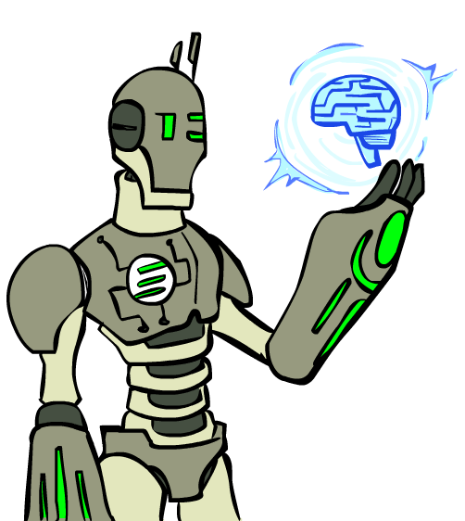

AI: Representation and Problem Solving
Knowledge Representation
Instructors: Pat Virtue & Stephanie Rosenthal
Slide credits: CMU AI, especially Tom Mitchell (NELL)

Slide 3
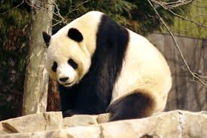
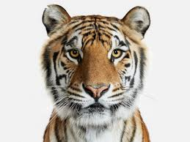
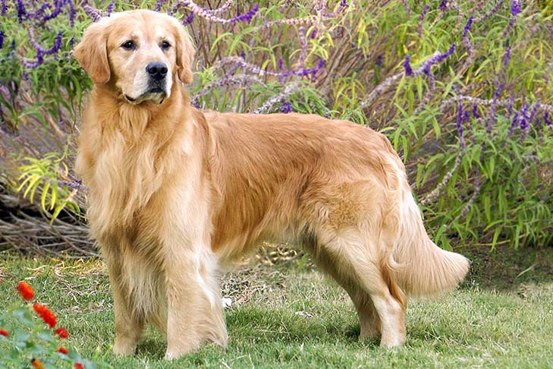
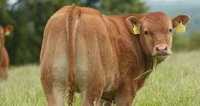
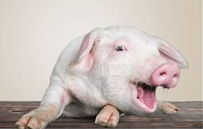
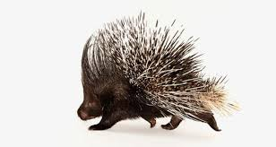
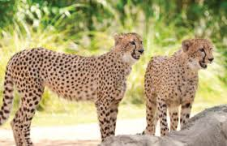
What is this?

Slide 4
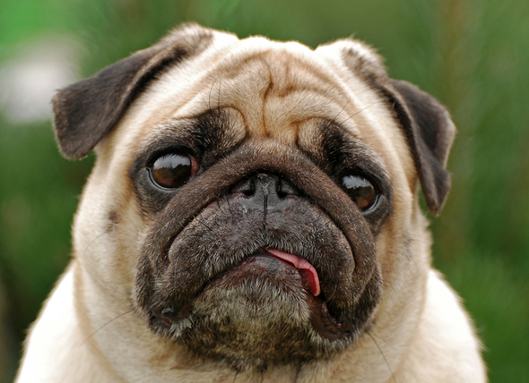
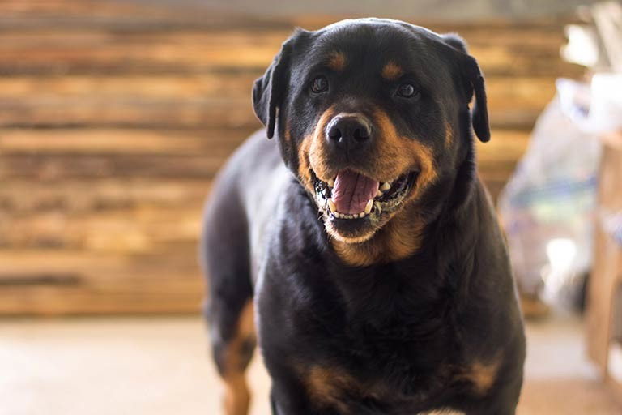
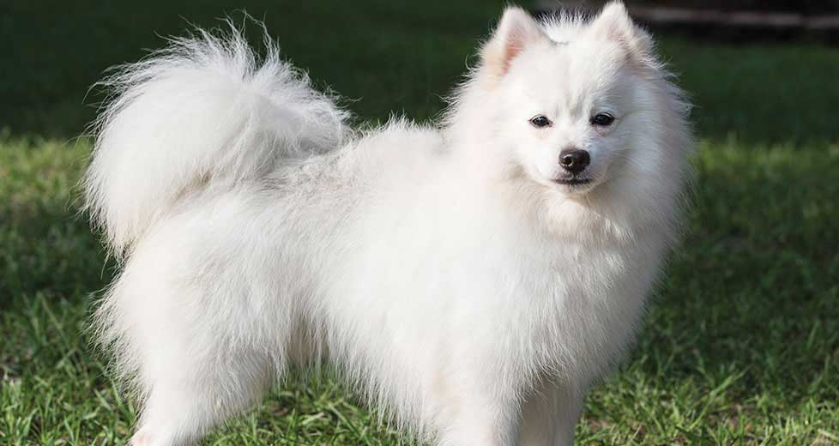
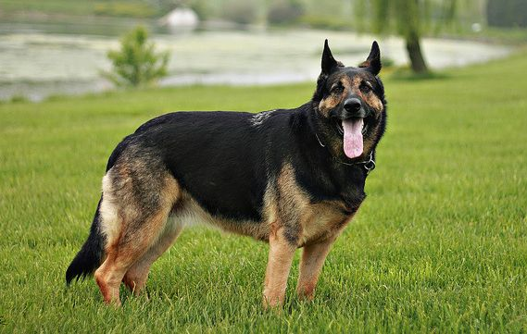
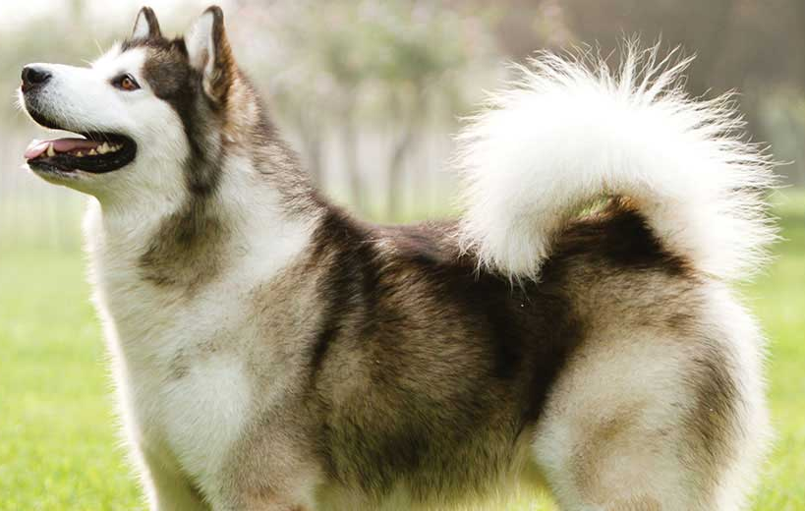
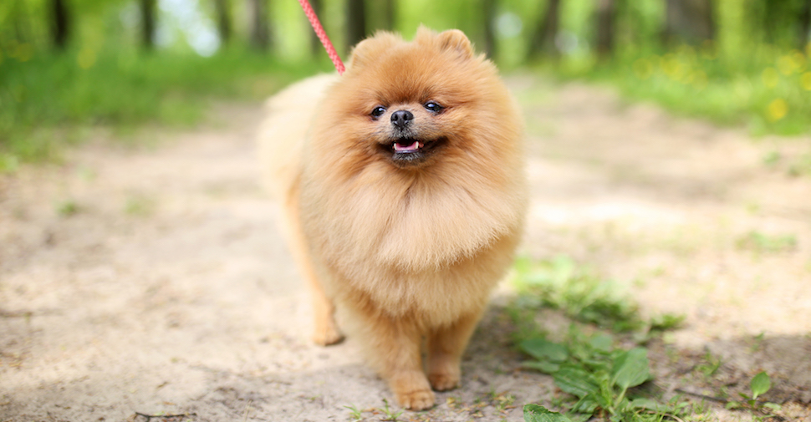
What is this?

Slide 5
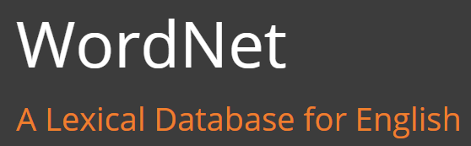

Ontologies
WordNet/ImageNet
https://wordnet.princeton.edu/
http://www.image-net.org/

Slide 6
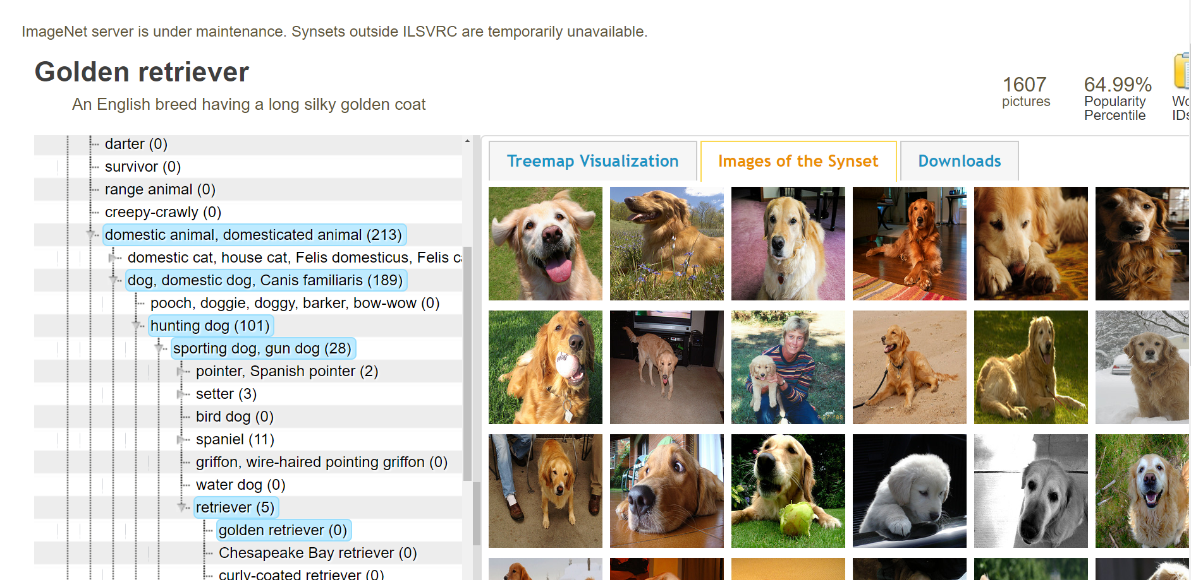
Ontologies
ImageNet
https://wordnet.princeton.edu/
http://www.image-net.org/

Slide 7
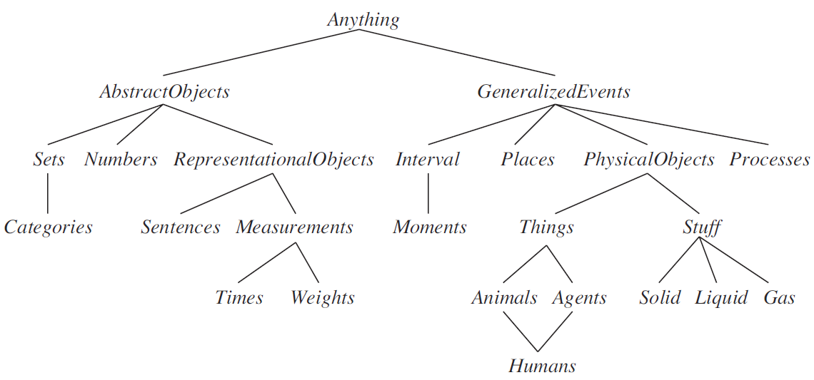
An “upper ontology” of the world
AIMA, Figure 12.1

Slide 8
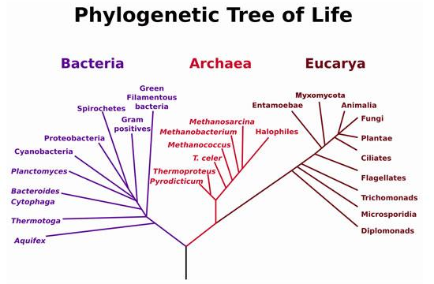
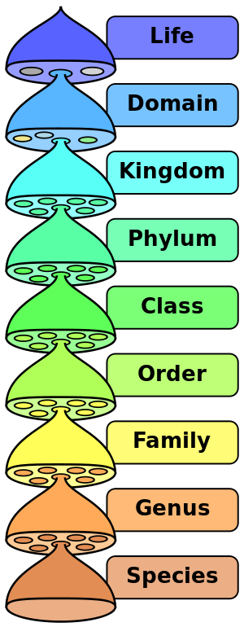
Taxonomic Hierarchies
10 million living and extinct species.

Slide 9
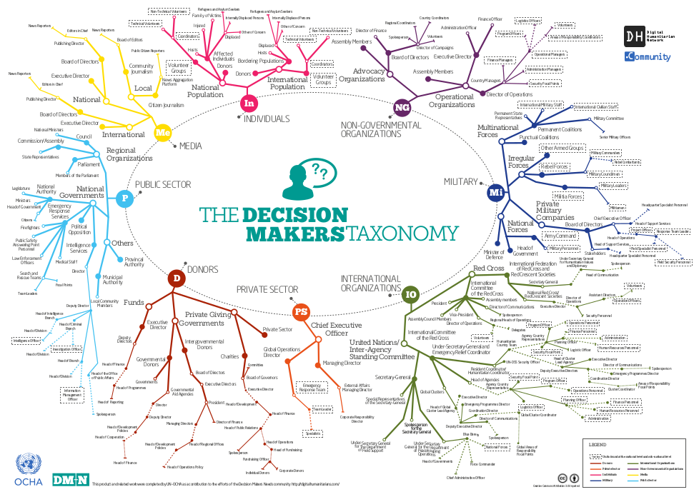
https://reliefweb.int/report/world/decision-makers-taxonomy

Slide 10
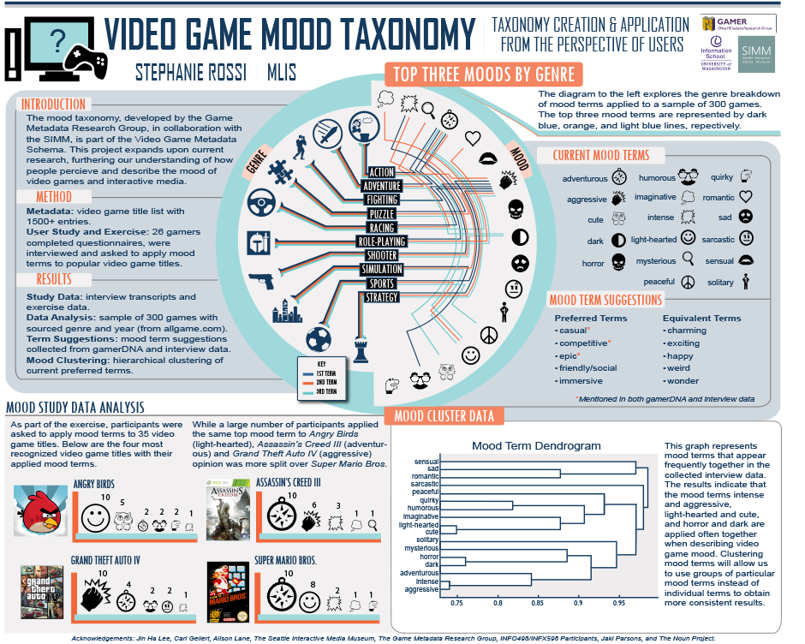

Slide 11
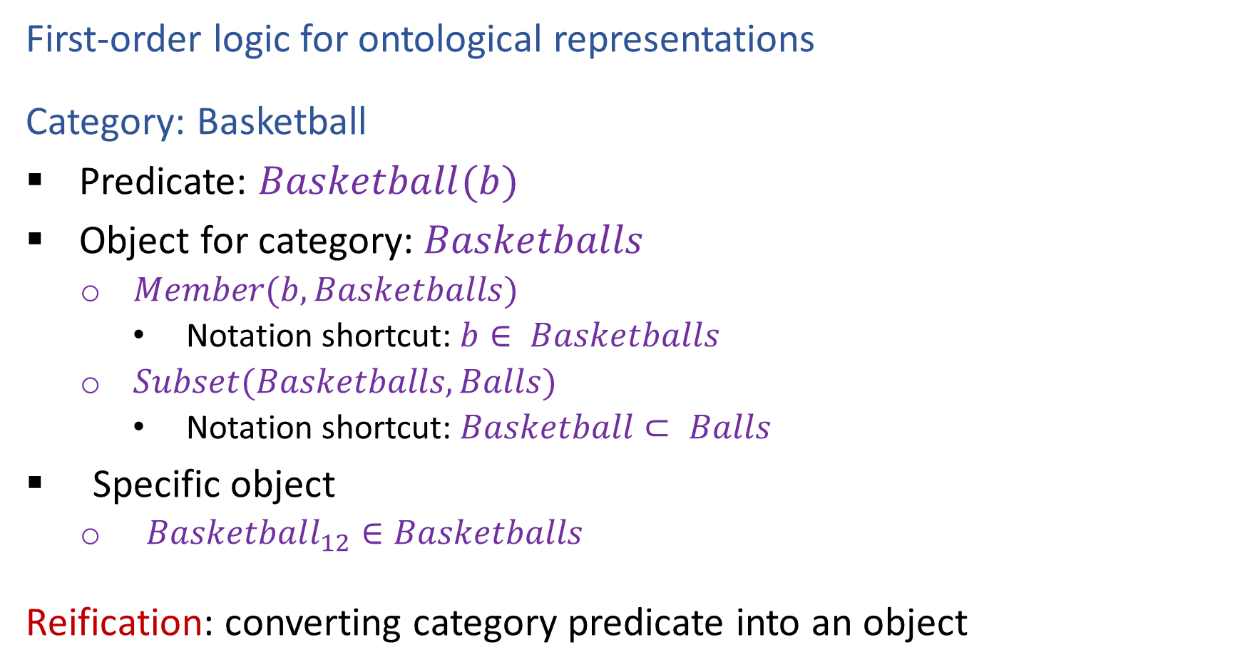
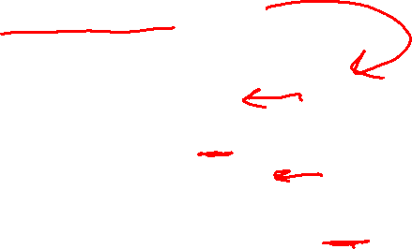
Categories and Objects
First-order logic for ontological representations
Category: Basketball
Predicate: $Basketball(b)$
Object for category: $Basketballs$
$Member(b, Basketballs)$
Notation shortcut: $b∈ Basketballs$
$Subset(Basketballs, Balls)$
Notation shortcut: $Basketball⊂ Balls$
Specific object
$Basketball_{12}∈Basketballs$
Reification: converting category predicate into an object

Slide 12
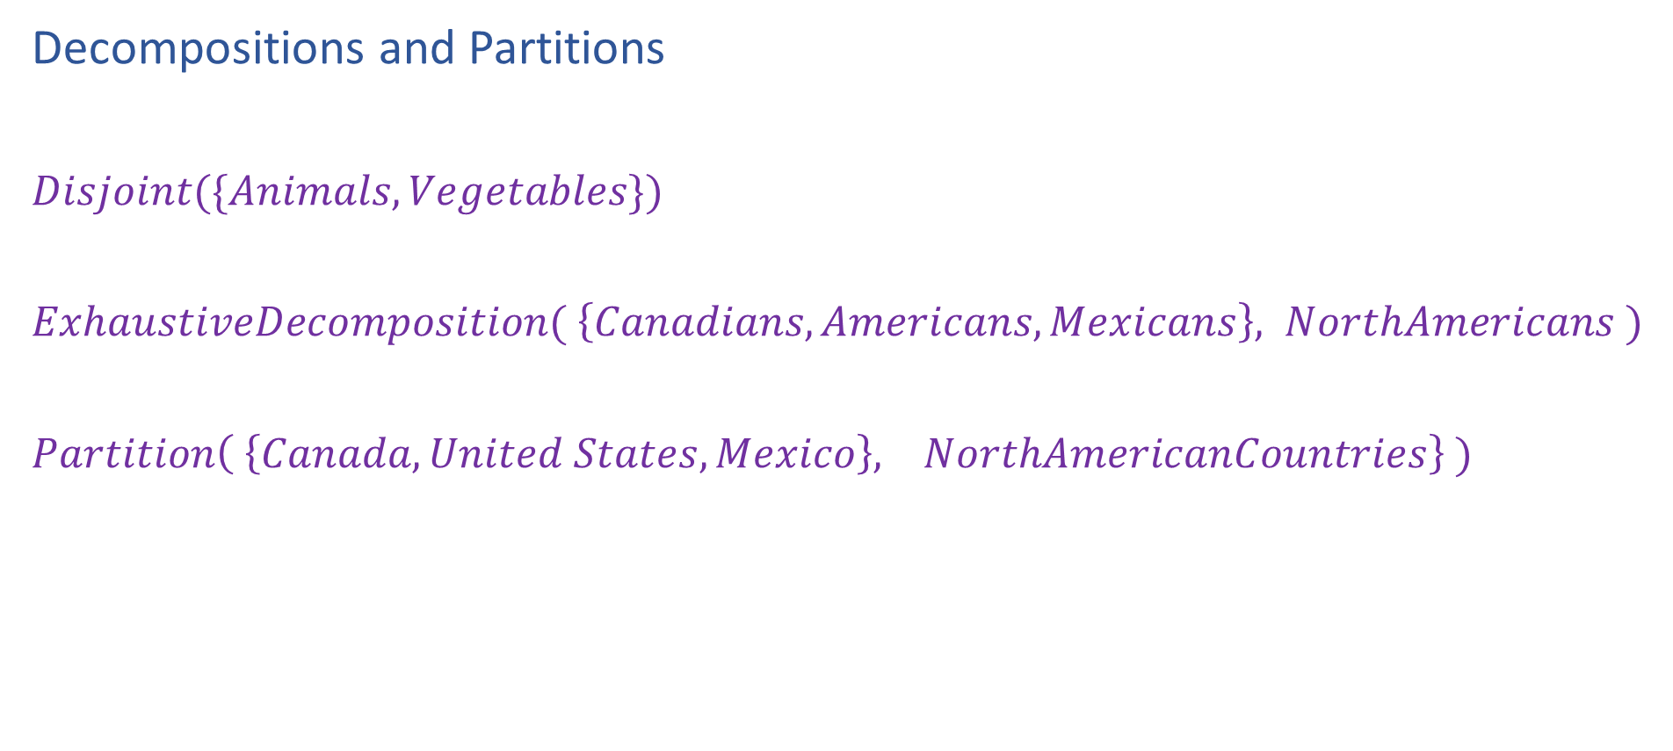
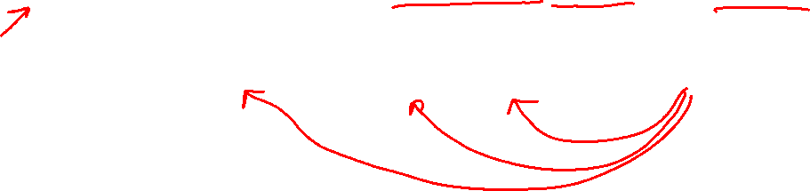
Categories and Objects
Decompositions and Partitions
$Disjoint(\{Animals, Vegetables\})$
$ExhaustiveDecomposition( \left\{Canadians,Americans,Mexicans\right\}, NorthAmericans )$
$Partition\left( \left\{Canada, United States, Mexico\right\}, NorthAmericanCountries\right\} )$

Slide 13
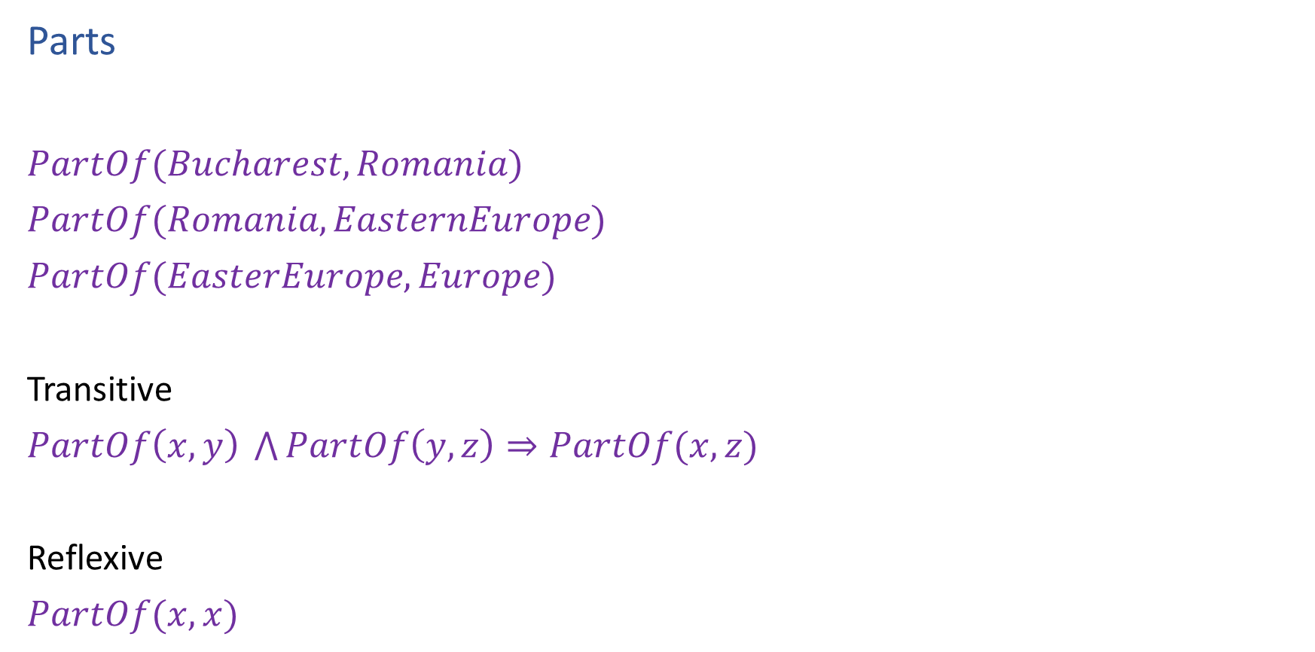
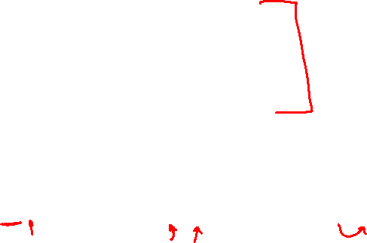
Categories and Objects
Parts
$PartOf(Bucharest, Romania)$
$PartOf(Romania, EasternEurope)$
$PartOf(EasterEurope, Europe)$
Transitive
$PartOf\left(x, y\right) \bigwedge{PartOf\left(y, z\right)}⇒PartOf(x, z)$
Reflexive
$PartOf(x, x)$

Slide 14
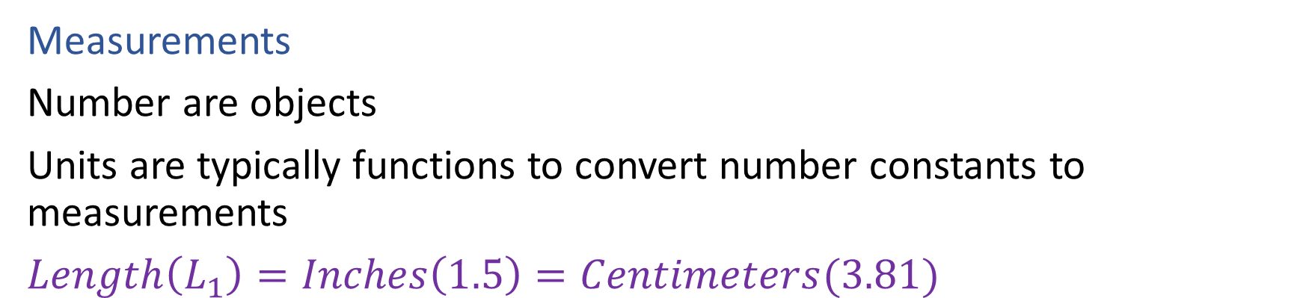

Categories and Objects
Measurements
Number are objects
Units are typically functions to convert number constants to measurements
$Length\left(L_{1}\right)=Inches\left(1.5\right)=Centimeters(3.81)$

Slide 15
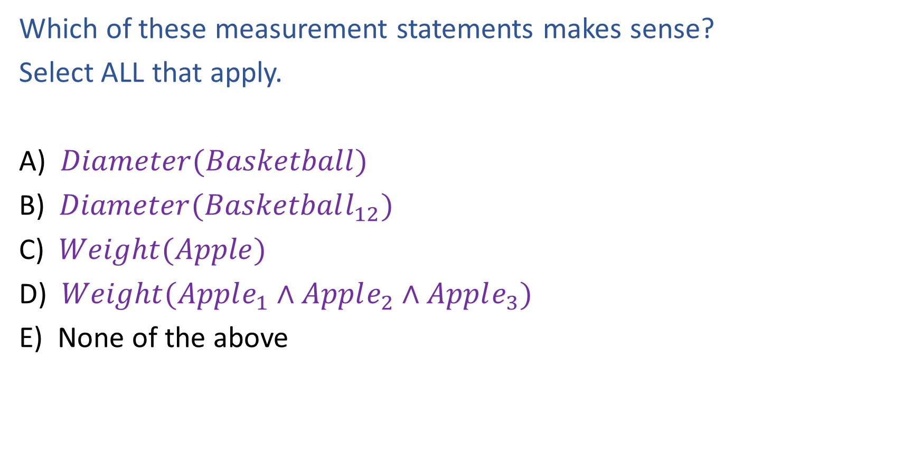
Piazza Poll 1
Which of these measurement statements makes sense?
Select ALL that apply.
A) $Diameter(Basketball)$
B) $Diameter(Basketball_{12})$
C) $Weight(Apple)$
D) $Weight(Apple_{1}∧Apple_{2}∧Apple_{3})$
E) None of the above

Slide 16
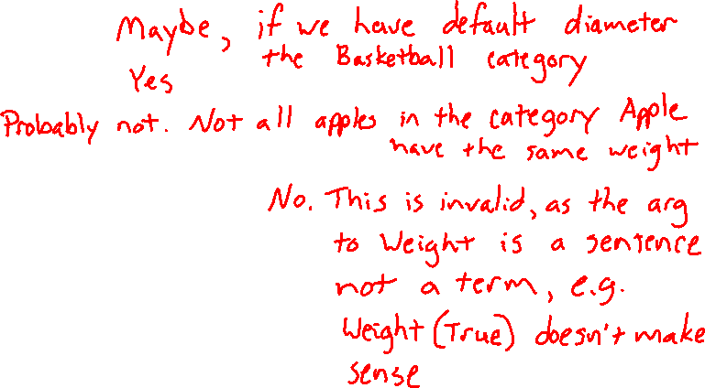
Piazza Poll 1
Which of these measurement statements makes sense?
Select ALL that apply.
A) $Diameter(Basketball)$
B) $Diameter(Basketball_{12})$
C) $Weight(Apple)$
D) $Weight(Apple_{1}∧Apple_{2}∧Apple_{3})$
E) None of the above

Slide 17
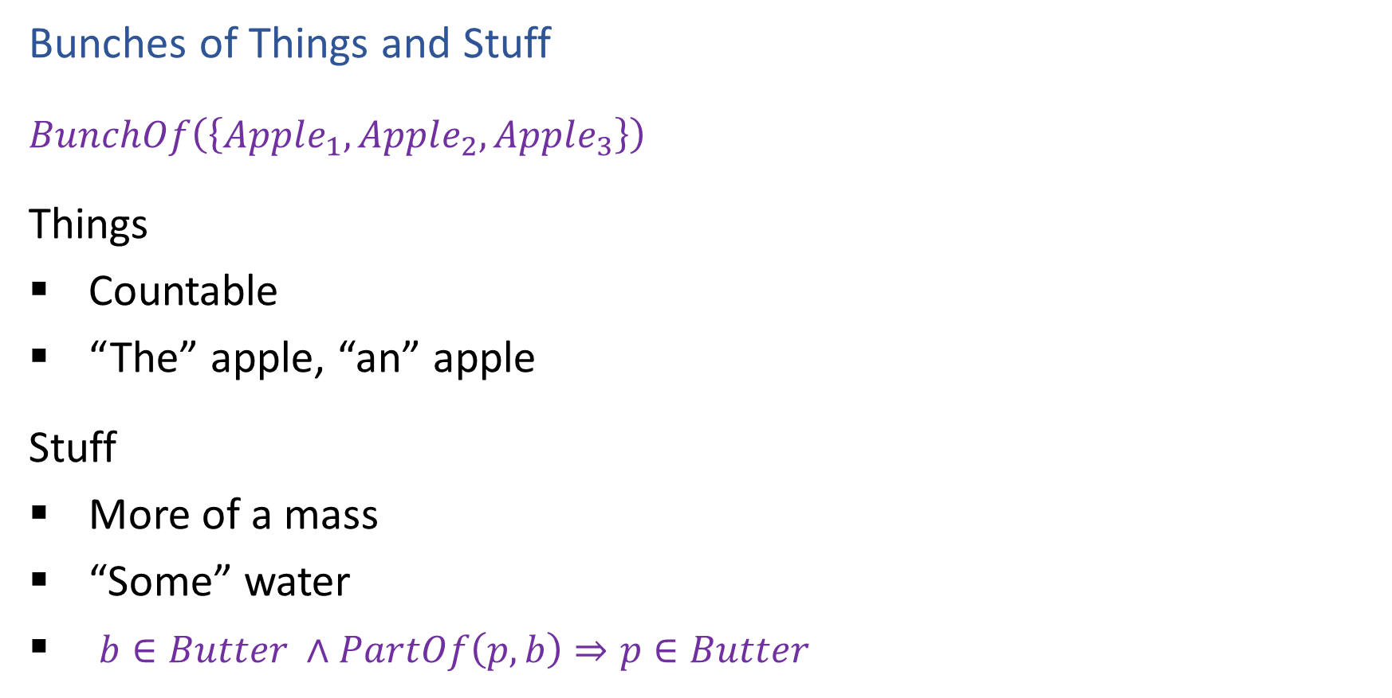

Categories and Objects
Bunches of Things and Stuff
$BunchOf\left(\left\{Apple_{1}, Apple_{2}, Apple_{3}\right\}\right)$
Things
Countable
“The” apple, “an” apple
Stuff
More of a mass
“Some” water
$b∈Butter ∧PartOf\left(p, b\right)⇒p∈Butter$

Slide 18
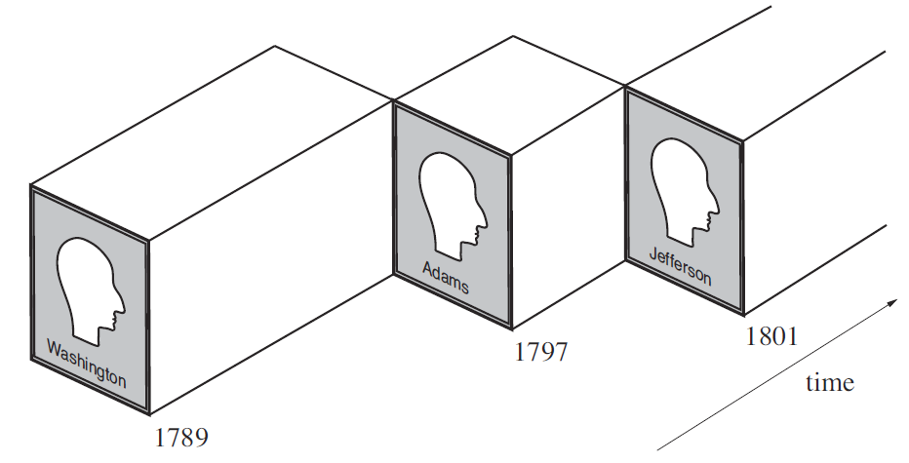
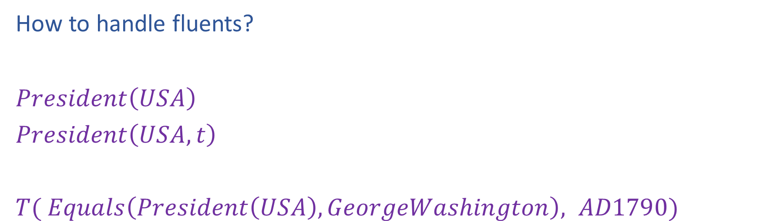

Events
How to handle fluents?
$President\left(USA\right)$
$President\left(USA, t\right)$
$T( Equals\left(President\left(USA\right), GeorgeWashington\right), AD1790)$
AIMA, Figure 12.3

Slide 19
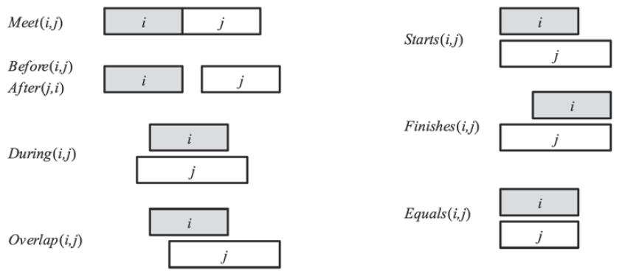
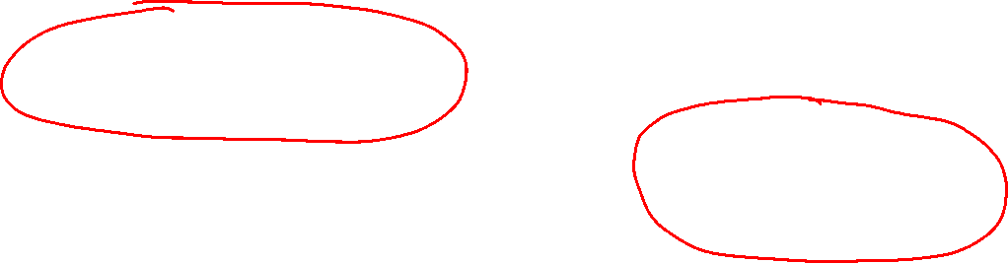
Events
How to handle time?
AIMA, Figure 12.2

Slide 20
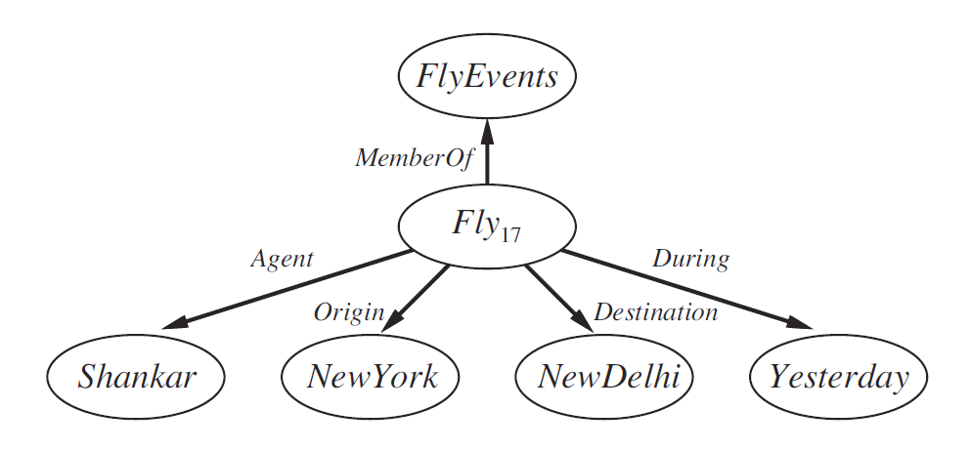

Semantic Networks
A graphical representation for some types of knowledge
Once viewed as an “alternative” to logic (it’s not really)
The IS-A relation often forms the backbone of a semantic network
Vertebrate
IS-A
Mammal
IS-A
Elephant
InstanceOf
Clyde

Slide 21
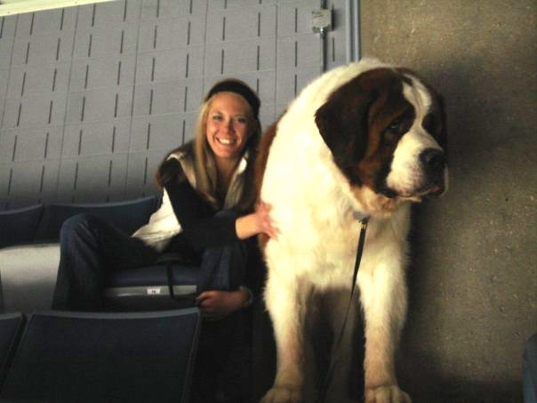
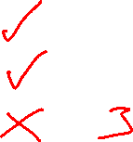
Semantic Networks
Reasoning with default information
Dog
Barks
Has Fur
Has four legs
Buster

Slide 22
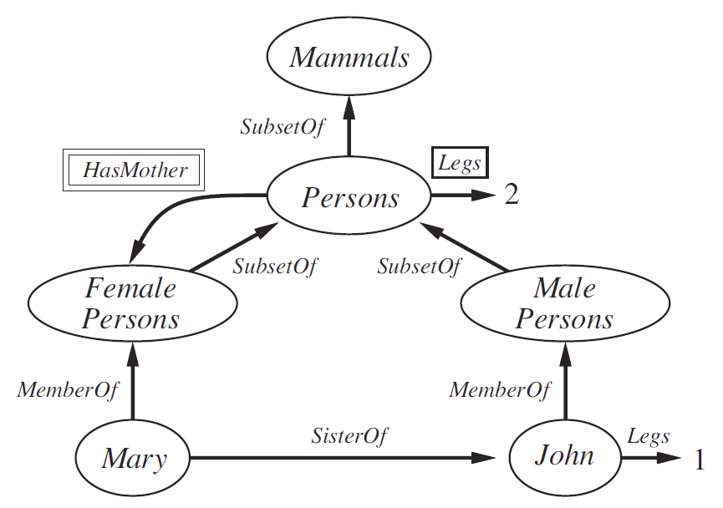
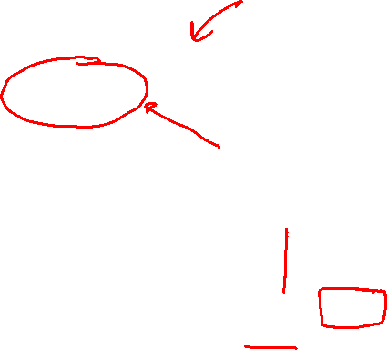
Semantic Networks
Reasoning with default information

Slide 23

Input, More Input!

Slide 24
Knowledge Representation in the Wild
WordNet
ImageNet
Wikimedia: Wikipedia, WikiData
Google Knowledge Graph
Schema.org
The “Semantic Web”
NELL: Never Ending Language Learning

Slide 25
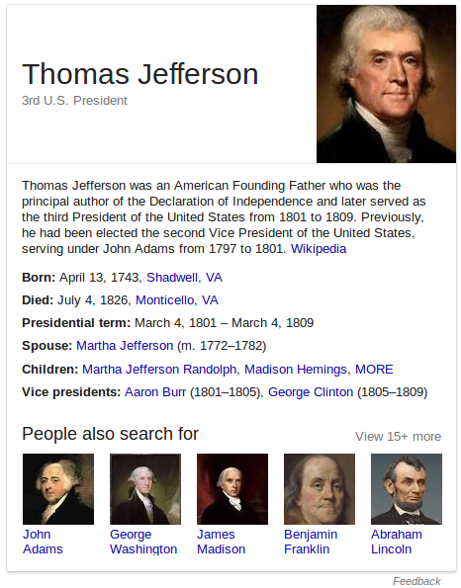
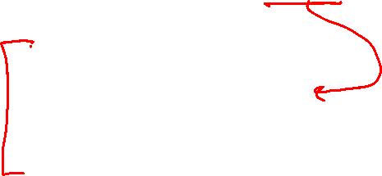
Knowledge panels in Google search results
The panels are generated from what’s called the Google Knowledge Graph.
Data comes from Wikipedia, CIA World Factbook, and other online sources.
As of Oct. 2016, held 70 billion facts.

Slide 26

Google Knowledge Graph API Access
import json import urllib api_key = open('.api_key').read() query = 'Taylor Swift' service_url = 'https://kgsearch.googleapis.com/v1/entities:search' params = { 'query': query, 'limit': 10, 'indent': True, 'key': api_key, }
url = service_url + '?' + urllib.urlencode(params) response = json.loads(urllib.urlopen(url).read()) for element in response['itemListElement']: print element['result']['name'] + ' (' + str(element['resultScore']) + ')'

Slide 27
Partial result
{ "@type": "EntitySearchResult", "result": { "@id": "kg:/m/0dl567", "name": "Taylor Swift", "@type": [ "Thing", "Person" ], "description": "Singer-songwriter", "image": { "contentUrl": "https://t1.gstatic.com/images?q=tbn:ANd9GcQm...", "url": "https://en.wikipedia.org/wiki/Taylor_Swift", "license": "http://creativecommons.org/licenses/by-sa/2.0" }, "detailedDescription": { ...

Slide 28
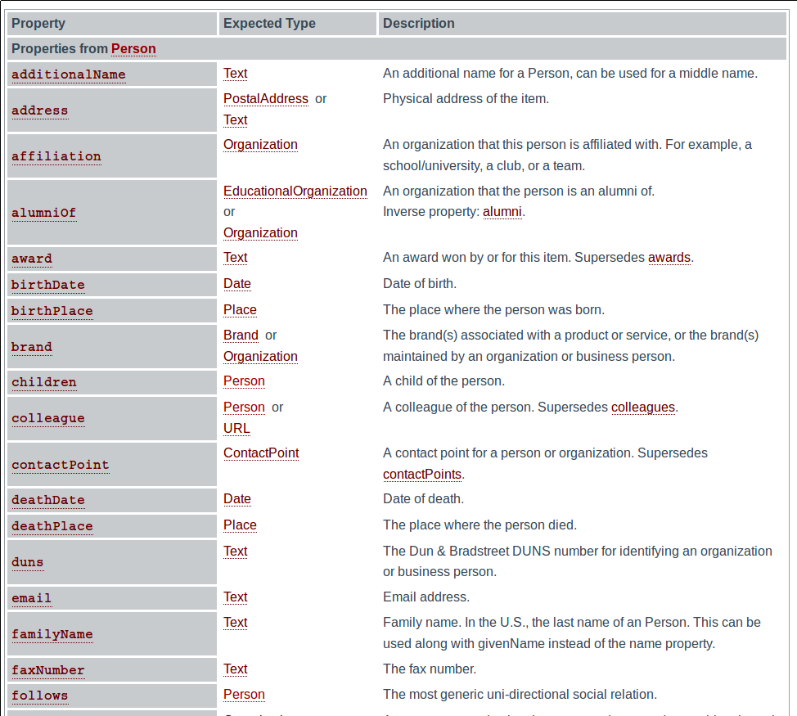
“Person” schema
at schema.org
Person
Canonical URL: http://schema.org/Person
Thing > Person
A person (alive, dead, undead, or fictional).
Usage: Over 1,000,000 domains

Slide 29
The Semantic Web
Term coined by Tim Berners-Lee
Common framework for exchange of data across application, enterprise, and community boundaries
HTML defines how text should look when presented to humans
Semantic web markup defines how information should be organized to be interpretable by machines
“Ontology engineer” is a job description now

Slide 30
NELL: Never-Ending Language Learner
Inputs:
initial ontology
few examples of each ontology predicate
the web
occasional interaction with human trainers
The task:
run 24x7, forever
each day:
extract more facts from the web to populate the initial ontology
learn to read (perform #1) better than yesterday

Slide 31
NELL Overview
Running 24x7, since January, 12, 2010
Inputs:
ontology defining >600 categories and relations
10-20 seed examples of each
500 million web pages
100,000 web search queries per day
~ 5 minutes/day of human guidance
Result:
KB with > 15 million candidate beliefs, growing daily
learning to reason, as well as read
automatically extending its ontology

Slide 32
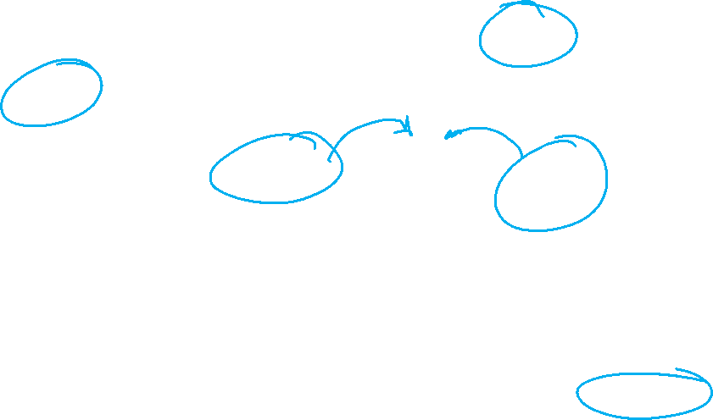
NELL knowledge fragment
football
uses equipment
climbing
skates
helmet
Canada
Sunnybrook
Miller
uses equipment
country
hospital
Wilson
city company
politician
CFRB
hockey
Detroit
GM
radio
Pearson
Toronto
play
airport
hired
hometown
competes with
home town
Maple Leafs
Stanley Cup
city company
Red Wings
city stadium
won
won
team stadium
Toyota
Connaught
city paper
league
league
city stadium
acquired
Maple Leaf Gardens
member
NHL
Hino
created
plays in
economic
sector
Globe and Mail
Sundin
Prius
writer
Toskala
automobile
Skydome
Corrola
Milson
Notes:
8. The result is a knowledge base of 15 million beliefs NELL is currently entertaining, with different levels of confidence. Beliefs such as “The Maple Leafs is a hockey team in Toronto” and “Toyota is an automobile company that competes with GM,” and “hockey equipment includes skates”

Slide 33
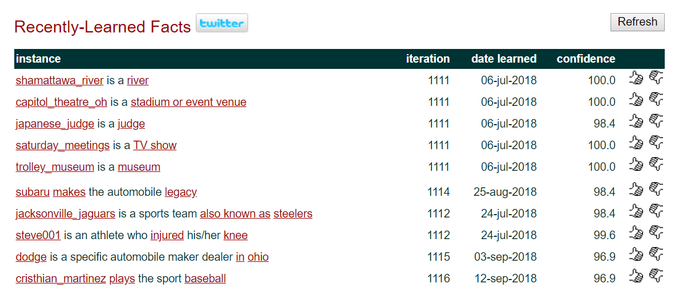
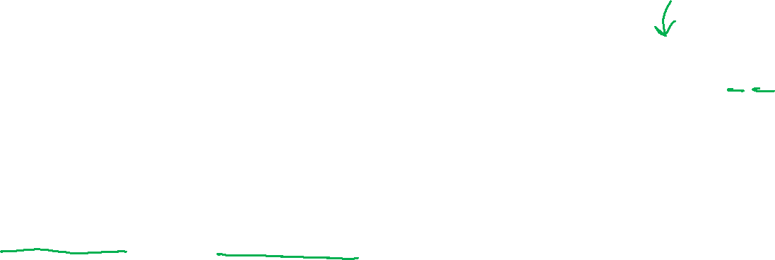
NELL Website
http://rtw.ml.cmu.edu ← follow NELL here
eg. “diabetes”, “Avandia”, ,“tea”, “IBM”, “love” “baseball” “BacteriaCausesCondition” …

Slide 34
Default Approach
Its underconstrained!!
Extract cities:
Paris
Pittsburgh
Seattle
Cupertino
San Francisco
Austin
denial
anxiety
selfishness
Berlin
mayor of arg1
live in arg1
arg1 is home of
traits such as arg1

Slide 35
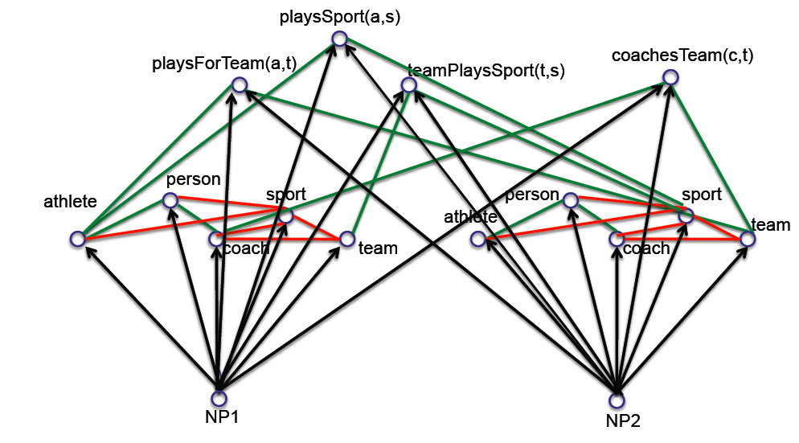
Key Idea 1: Coupled semi-supervised training of many functions
person
NP
hard (underconstrained) semi-supervised learning problem
much easier (more constrained)
semi-supervised learning problem

Slide 36

Type 1 Coupling: Co-Training, Multi-View Learning
[Blum & Mitchell; 98]
[Dasgupta et al; 01 ]
[Ganchev et al., 08]
[Sridharan & Kakade, 08]
[Wang & Zhou, ICML10]
person
f₁(NP)
f₃(NP)
f₂(NP)
NP text context distribution
NP morphology
NP HTML contexts
NP:
__ is a friend
rang the __
…
__ walked in
capitalized?
ends with ‘...ski’?
…
contains “univ.”?
www.celebrities.com:
<li> __ </li>
…

Slide 37
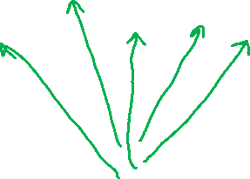
Type 2 Coupling: Multi-task, Structured Outputs
[Daume, 2008]
[Bakhir et al., eds. 2007]
[Roth et al., 2008]
[Taskar et al., 2009]
[Carlson et al., 2009]
person
athlete
sport
coach
team
athlete(NP) → person(NP)
NP
athlete(NP) → NOT sport(NP)
NOT athlete(NP) ← sport(NP)

Slide 38
Multi-view, Multi-Task Coupling
person
athlete
sport
coach
team
NP text context distribution
NP morphology
NP HTML contexts
NP:

Slide 39
Learning Relations between NP’s
playsSport(a,s)
playsForTeam(a,t)
coachesTeam(c,t)
teamPlaysSport(t,s)
NP1
NP2

Slide 40
playsSport(a,s)
playsForTeam(a,t)
coachesTeam(c,t)
teamPlaysSport(t,s)
person
athlete
sport
person
sport
athlete
team
coach
team
coach
NP1
NP2

Slide 41

Type 3 Coupling: Argument Types
playsSport(NP1,NP2) → athlete(NP1), sport(NP2)
playsSport(a,s)
playsForTeam(a,t)
coachesTeam(c,t)
teamPlaysSport(t,s)
person
athlete
sport
person
sport
athlete
team
coach
team
coach
over 2500 coupled functions in NELL
NP1
NP2

Slide 42

Basic NELL Architecture
Knowledge Base
(latent variables)
Beliefs
Evidence Integrator
Candidate
Beliefs
Continually Learning Extractors
Text Context patterns
(CPL)
HTML-URL
context patterns
(SEAL)
Morphology
classifier
(CML)

Slide 43
NELL: Learned reading strategies
Plays_Sport(arg1,arg2):
arg1_was_playing_arg2 arg2_megastar_arg1 arg2_icons_arg1 arg2_player_named_arg1 arg2_prodigy_arg1 arg1_is_the_tiger_woods_of_arg2 arg2_career_of_arg1 arg2_greats_as_arg1 arg1_plays_arg2 arg2_player_is_arg1 arg2_legends_arg1 arg1_announced_his_retirement_from_arg2 arg2_operations_chief_arg1 arg2_player_like_arg1 arg2_and_golfing_personalities_including_arg1 arg2_players_like_arg1 arg2_greats_like_arg1 arg2_players_are_steffi_graf_and_arg1 arg2_great_arg1 arg2_champ_arg1 arg2_greats_such_as_arg1 arg2_professionals_such_as_arg1 arg2_hit_by_arg1 arg2_greats_arg1 arg2_icon_arg1 arg2_stars_like_arg1 arg2_pros_like_arg1 arg1_retires_from_arg2 arg2_phenom_arg1 arg2_lesson_from_arg1 arg2_architects_robert_trent_jones_and_arg1 arg2_sensation_arg1 arg2_pros_arg1 arg2_stars_venus_and_arg1 arg2_hall_of_famer_arg1 arg2_superstar_arg1 arg2_legend_arg1 arg2_legends_such_as_arg1 arg2_players_is_arg1 arg2_pro_arg1 arg2_player_was_arg1 arg2_god_arg1 arg2_idol_arg1 arg1_was_born_to_play_arg2 arg2_star_arg1 arg2_hero_arg1 arg2_players_are_arg1 arg1_retired_from_professional_arg2 arg2_legends_as_arg1 arg2_autographed_by_arg1 arg2_champion_arg1 …

Slide 44
If coupled learning is the key, how can we get new coupling constraints?

Slide 45
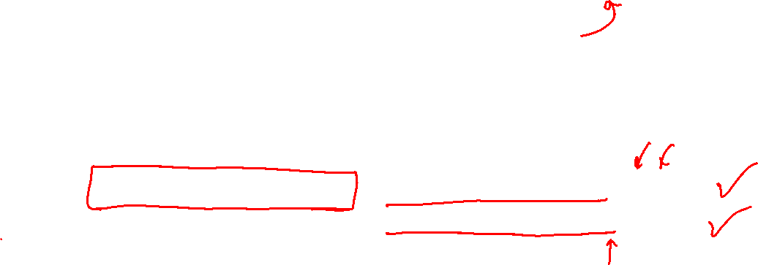
Key Idea 2: Discover New Coupling Constraints
first order, probabilistic horn clause constraints:
connects previously uncoupled relation predicates
infers new beliefs for KB
0.93 athletePlaysSport(?x,?y) ← athletePlaysForTeam(?x,?z)
teamPlaysSport(?z,?y)

Slide 46
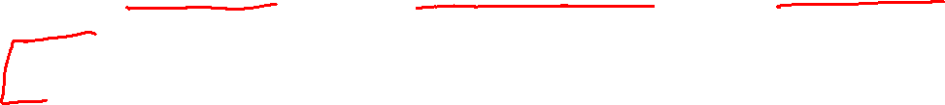
Example Learned Horn Clauses
0.95
0.93
0.91
0.90
athletePlaysSport(?x,basketball) ← athleteInLeague(?x,NBA)
athletePlaysSport(?x,?y) ← athletePlaysForTeam(?x,?z)
teamPlaysSport(?z,?y)
teamPlaysInLeague(?x,NHL) ← teamWonTrophy(?x,Stanley_Cup)
athleteInLeague(?x,?y) ←athletePlaysForTeam(?x,?z),
teamPlaysInLeague(?z,?y)
cityInState(?x,?y) ← cityCapitalOfState(?x,?y), cityInCountry(?y,USA)
newspaperInCity(?x,New_York) ← companyEconomicSector(?x,media)
generalizations(?x,blog)
0.88
0.62*

Slide 47

Some rejected learned rules
cityCapitalOfState{?x ?y} ← cityLocatedInState{?x ?y}, teamPlaysInLeague{?y nba}
teamplayssport{?x, basketball} ← generalizations{?x, university}

Slide 48
Learned Probabilistic Horn Clause Rules
0.93 playsSport(?x,?y) ← playsForTeam(?x,?z), teamPlaysSport(?z,?y)
playsSport(a,s)
playsForTeam(a,t)
coachesTeam(c,t)
teamPlaysSport(t,s)
person
athlete
sport
person
sport
athlete
team
coach
team
coach
NP1
NP2

Slide 49
Key Idea 3: Automatically extend ontology

Slide 50
Ontology Extension (1)
[Mohamed et al., EMNLP 2011]
Goal:
Add new relations to ontology
Approach:
For each pair of categories C1, C2,
co-cluster pairs of known instances, and text contexts that connect them

Slide 51

Example Discovered Relations
[Mohamed et al. EMNLP 2011]
Category Pair | Text contexts | Extracted Instances | Suggested Name
MusicInstrument Musician | ARG1 master ARG2 ARG1 virtuoso ARG2 ARG1 legend ARG2 ARG2 plays ARG1 | sitar , George Harrison tenor sax, Stan Getz trombone, Tommy Dorsey vibes, Lionel Hampton | Master
Disease Disease | ARG1 is due to ARG2 ARG1 is caused by ARG2 | pinched nerve, herniated disk tennis elbow, tendonitis blepharospasm, dystonia | IsDueTo
CellType Chemical | ARG1 that release ARG2 ARG2 releasing ARG1 | epithelial cells, surfactant neurons, serotonin mast cells, histomine | ThatRelease
Mammals Plant | ARG1 eat ARG2 ARG2 eating ARG1 | koala bears, eucalyptus sheep, grasses goats, saplings | Eat
River City | ARG1 in heart of ARG2 ARG1 which flows through ARG2 | Seine, Paris Nile, Cairo Tiber river, Rome | InHeartOf

Slide 52
NELL: recently self-added relations
athleteWonAward
animalEatsFood
languageTaughtInCity
clothingMadeFromPlant
beverageServedWithFood
fishServedWithFood
athleteBeatAthlete
athleteInjuredBodyPart
arthropodFeedsOnInsect
animalEatsVegetable
plantRepresentsEmotion
foodDecreasesRiskOfDisease
clothingGoesWithClothing
bacteriaCausesPhysCondition
buildingMadeOfMaterial
emotionAssociatedWithDisease
foodCanCauseDisease
agriculturalProductAttractsInsect
arteryArisesFromArtery
countryHasSportsFans
bakedGoodServedWithBeverage
beverageContainsProtein
animalCanDevelopDisease
beverageMadeFromBeverage

Slide 53
Key Idea 4: Cumulative, Staged Learning
Learning X improves ability to learn Y
Classify noun phrases (NP’s) by category
Classify NP pairs by relation
Discover rules to predict new relation instances
Learn which NP’s (co)refer to which concepts
Discover new relations to extend ontology
Learn to infer relation instances via targeted random walks
Learn to assign temporal scope to beliefs
Learn to microread single sentences
Vision: co-train text and visual object recognition
Goal-driven reading: predict, then read to corroborate/correct
Make NELL a conversational agent on Twitter
Add a robot body to NELL

